Slide 1
CREDIT CARD LEAD PREDICTION Submitted by: Priyal Agarwal

Slide 2
Project Introduction:
Happy Customer Bank is a mid-sized private bank that deals in all kinds of banking products, like Savings accounts, Current accounts, investment products, credit products, among other offerings.
The bank also cross-sells products to its existing customers and to do so they use different kinds of communication like tele-calling, e-mails, recommendations on net banking, mobile banking, etc.
In this case, the Happy Customer Bank wants to cross sell its credit cards to its existing customers. The bank has identified a set of customers that are eligible for taking these credit cards.
Bank wants to identify customers that could show higher intent towards a recommended credit card, given:
Customer details (gender, age, region etc.)
Details of his/her relationship with the bank (Channel_Code,Vintage, 'Avg_Asset_Value etc.)
Building a model that's capable of identifying customers who are interested for the credit card .

Slide 3



Project analysis slide 3
Mathematical/ Analytical Modelling of the Problem/Exploratory Data Analysis Steps
DATA FEATURES CHECK
NULL VALUE CHECK
CHECK DATATYPES
DATA
SOURCE
STATISTICS CHECK
Extract feature information about dataset such as number of rows ,columns and data types of the different features.
In this dataset, we have 351037 rows with 12 features.
.
Check for the datatypes of features present in our dataset.
There are 6 categorical features that needs to be converted in numerical datatype by using Label Encoder.
Check for the null values present in our dataset.
Null values are present in our dataset in ‘Credit_Product’ feature.
This part tells about the statistics i.e. mean, median, max value ,min values ,75% and it also gives some sort of outliers’ analysis
The data is provided from Analytics Vidhya platform contest named JOB-A-THON.

Slide 4
Project analysis slide 2
Data Pre-processing Steps
1. Separate minority and
Majority classes
4. Using undersampled dataset
for further modelling
Steps
2. Undersample majority class
5. Dropping target variable
3. Combining minority class
with oversampled majority class
6. Using Standard Scaler to
standardize the value of x .

Slide 5
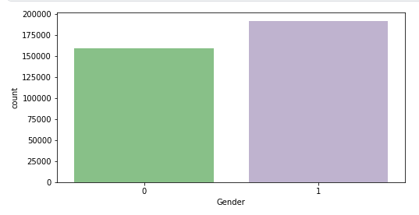
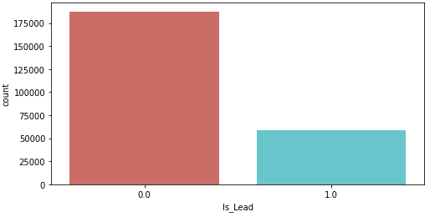
Project analysis slide 8
Visualizations
Univariate Analysis:
Countplot for ‘Gender’ variable
Countplot for ‘Is_Lead’ (Target ) variable
Observation: More Male customers are present in the dataset.
Observation: It shows that data is highly imbalanced and needs to be corrected .

Slide 6
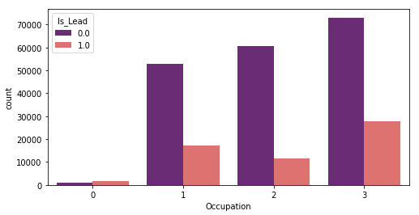
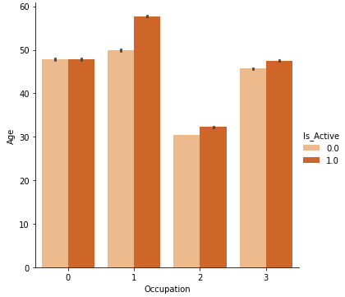
Project analysis slide 8
Visualizations
Bivariate Analysis:
Checking occupation with customers interest
Checking Activness of customer in last 3 months
Observation: Self employed customers are less likely to get the credit card. Whereas entrepreneurs (though limited) are most likely to get credit card.
Observation: Active customers are more in salaried, self_employed and others as compared to entrepreneur in last 3 months.

Slide 7
Modelling Parts
Imbalanced dataset is normalized for final modeling .
After splitting the data for input and output Standard Scaler is applied to data.
After train test split applied all the classification algorithms to find the best scoring one.
As this is a Classification Problem so we have used F1 score, Accuracy Score, Confusion Matrix and ROC curve for evaluation of final model.
We have used ROC score and ROC_AUC curve to finalize testing dataset prediction results.
On the basis of AUC score , finalized Random Forest Algorithm for initial predictions.

Slide 8
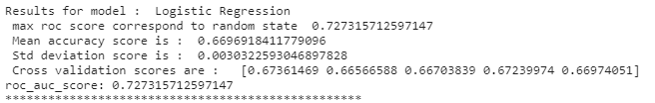
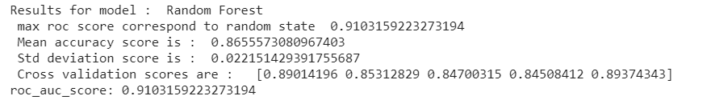
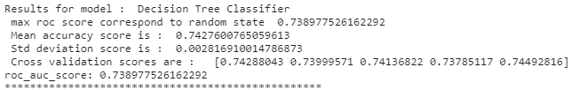
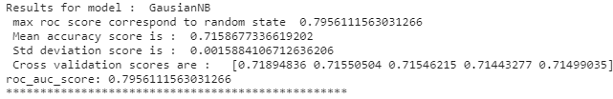
Project analysis slide 8
Algorithms Used
Logistic Regression
Random Forest
Decision Tree Classifier
GausianNB
Observation: On the basis of AUC score , finalized Random Forest Algorithm for initial predictions.

Slide 9
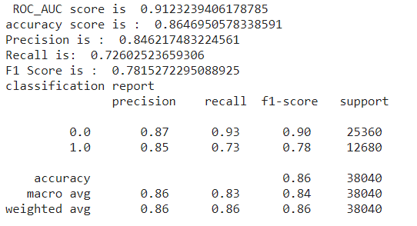
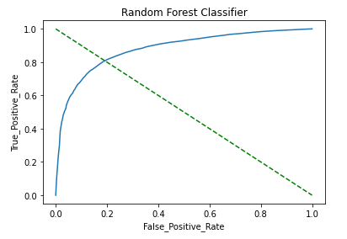
Project analysis slide 10
Attempt 1 : Random Forest Classifier
Result
Base model selected is Random Forest (selected on basis of AUC score) which provides max ROC score of 0.91
Plotted AOC/ROC line that shows good match between test and predicted values.
Also plotted confusion matrix, Overall model fit is good
However, as the predicted probability was meaned in RF model upto 2 decimal places the resultant AUC score with test data was found to be ~ 0.85

Slide 10
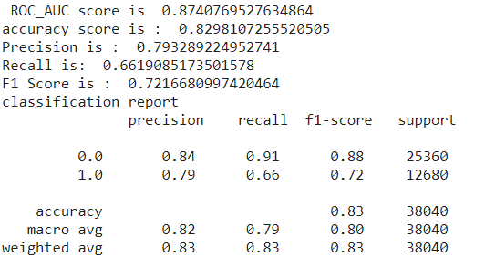

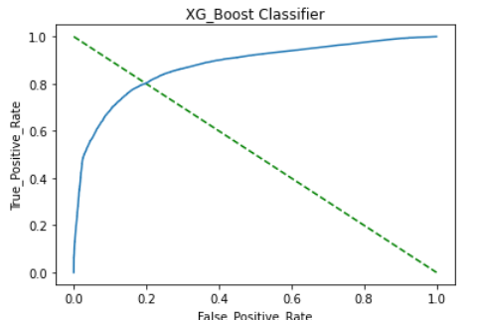
Project analysis slide 10
Attempt 2 : XG Boost Classifier
Result
Base model selected is XG Boost Classifer selected to boost accuracy in imbalanced class classification program.
Plotted AOC/ROC line that shows good match between test and predicted values.
Max ROC score is 0.87, Overall model fit is good.
However, XG boost AUC score with test data dropped to ~ 0.86 due to overfitting issues.

Slide 11
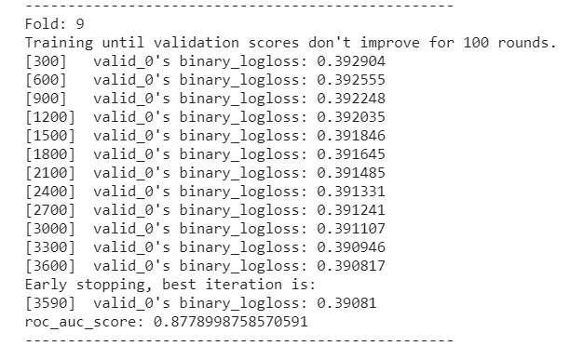
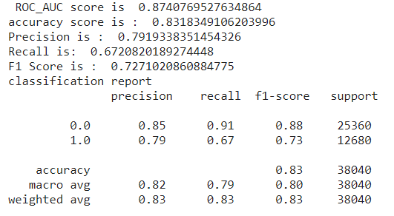
Project analysis slide 10
Attempt 3 : LGBM Model with Stratification Folds
Result
Base model selected is LGBM classifier model along with stratified cross-validation of 10 folds .
This was done to remove any overfitting issues in the model.
Plotted AOC/ROC line that shows good match between test and predicted values.
Max ROC score is 0.874
Final model is selected as LGBM model as it is most consistent model with highest AUC score in test data

Slide 12
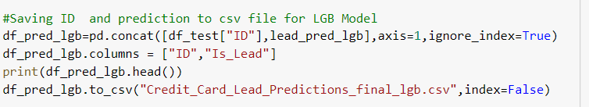

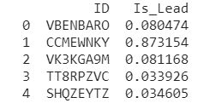
Project analysis slide 10
Final Model - Prediction
Result
Predictions were made using various models against test data – RandomForest , XG Boost and LGBM.
Following AUC score was observed:
RandomForest – 0.854
XG Boost – 0.86
LGBM – 0.87
Final predictions with LGBM is chosen and model saved to pkl file and predictions saved to csv file

Slide 13
Conclusion
Data contained both categorical and numerical data. Converted categories to numerical for EDA analysis.
Also conducted visual analysis to observe following:
IndentActive customers are more in salaried,self_employed and others as compared to entrepreneur in last 3 months.
Data is skewed towards left in Avg_Account_Balance
Target Variable is imbalanced and needed to be corrected for proper modelling.
Dataset was balanced by using under sampling technique.
Random Forest Classifier:
Found RandomForest model had the highest AUC score(0.91) among various base models.
However, as the predicted probability was mean in RF model upto 2 decimal places the resultant AUC score with test data was found to be ~ 0.85
XG Boost Classifier:
To further boost the accuracy XG Boost method was used and AUC score of 0.87 was found with the training data.
However, XG boost AUC score with test data dropped to ~ 0.86 due to overfitting issues.
LGBM Classifier with stratified cross-validation:
To solve overfitting issues, LGBM model with 10-fold cross-validation was used and AUC score 0.874 with training data.
Model performed very well with test data and provided AUC score of ~0.871
Hence, final model is selected as LGBM model as it is most consistent model with highest AUC score.

Slide 14
Thank You

